Slide 1


OPTIMIZATION OF
Machine Downtime
DA/DS Project Batch-59
● BY RAHUL KUMAR
● B.Tech(CSE) -Graduate, 2023
● Contact-7762911463,8789169384
● Linkdein-https://www.linkedin.com/in/rahul-kumar-380441172/

Slide 2
Business Objective
Business Constraints
Project Architecture - Data Flow Diagram
Data Collection
Exploratory Data Analysis
Data Visualization
CONTENTS

Slide 3
Business Problem
Unplanned machine downtime leading to loss of productivity
Business Objective
Minimize unplanned machine downtime
Business Constraints
- Minimize maintenance cost
- Maximize equipment efficiency

Slide 4
Project Overview and Scope
Project Overview:
The project focuses on analyzing machine downtime to identify key factors contributing to machine failures. The primary goal is to reduce unplanned downtime by understanding how different operational variables impact machine performance. By leveraging data analysis techniques, the project aims to uncover patterns and correlations that can lead to actionable insights, helping to improve overall machine reliability and efficiency.
Scope of the Project:
Data Preparation
- Cleaned and preprocessed data from various machine sensors.
- Addressed missing values and outliers for accurate analysis.
Exploratory Data Analysis (EDA)
- Conducted statistical tests and correlation analysis to identify the impact of key variables on downtime.
Insights and Recommendations
- Identified critical factors contributing to machine failures.
- Provided actionable recommendations to reduce downtime by at least 10% and achieve
cost savings of $1M.

Slide 5
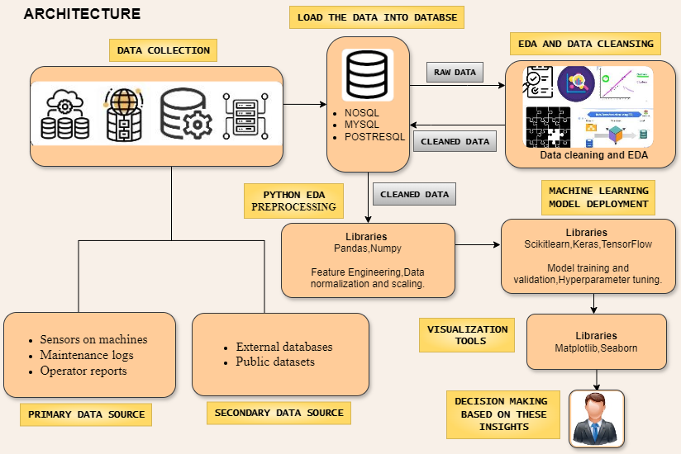
Project Architecture - Data Flow Diagram

Slide 6
Data Dictionary
Hydraulic Pressure
Measures the pressure in the hydraulic system of the machine. Critical for maintaining proper machine function.
Coolant Pressure
Indicates the pressure within the machine's coolant system, which is essential for preventing overheating.
Air System Pressure
Tracks the pressure in the air system, which may be used for pneumatic tools or cooling processes.
Coolant Temperature
Monitors the temperature of the coolant, which affects the machine's ability to dissipate heat.
Hydraulic Oil Temperature
Measures the temperature of the hydraulic oil, which is crucial for maintaining fluid viscosity and preventing wear.
Spindle Bearing Temperature
Records the temperature of the spindle bearings, which impacts the spindle's lifespan and performance.

Slide 7
Data Dictionary
Spindle Vibration
Captures the vibration levels of the spindle, which can indicate potential mechanical issues or misalignments.
Tool Vibration
Measures vibration at the tool, which affects the quality of machining and tool wear.
Spindle Speed
Indicates the rotational speed of the spindle, a key factor in machining efficiency and quality.
Voltage
Monitors the electrical voltage supplied to the machine, which can affect its performance and safety.
Torque
Measures the torque applied during machining, which influences the cutting force and machine strain.
Cutting
Represents the cutting conditions, such as feed rate and depth, that directly impact machining outcomes.
Downtime
Categorical variable indicating whether the machine experienced a failure (Machine_Failure) or not (No_Machine_Failure).

Slide 8
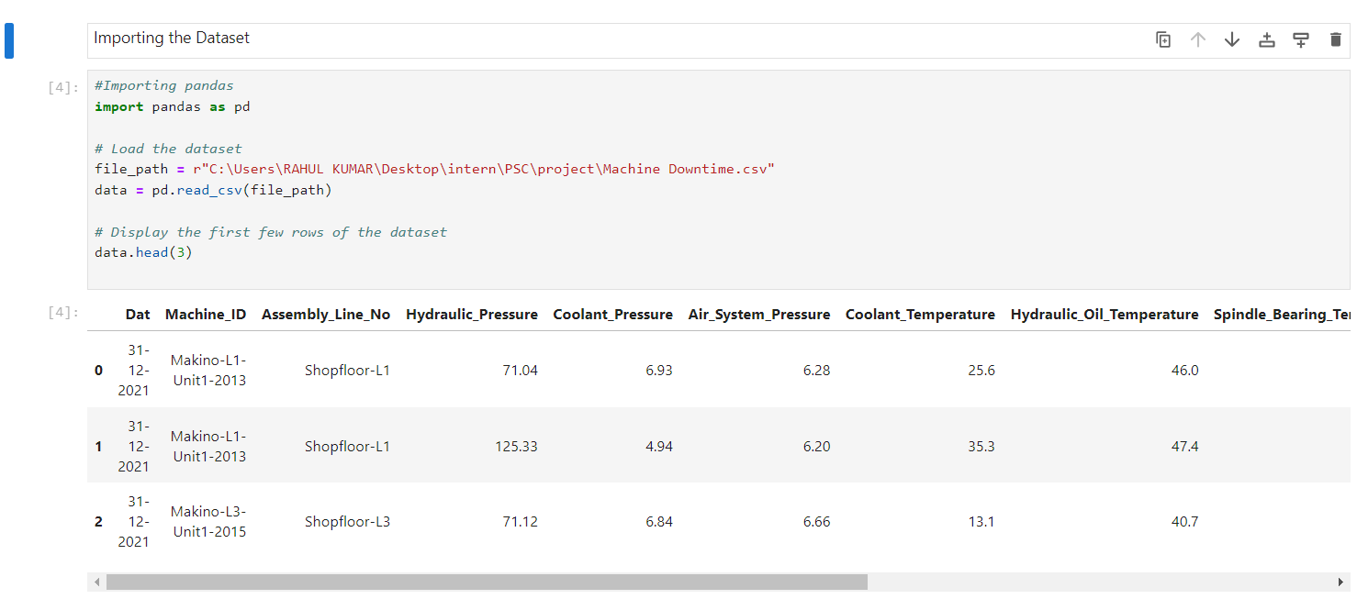
Exploratory Data Analysis [EDA]

Slide 9
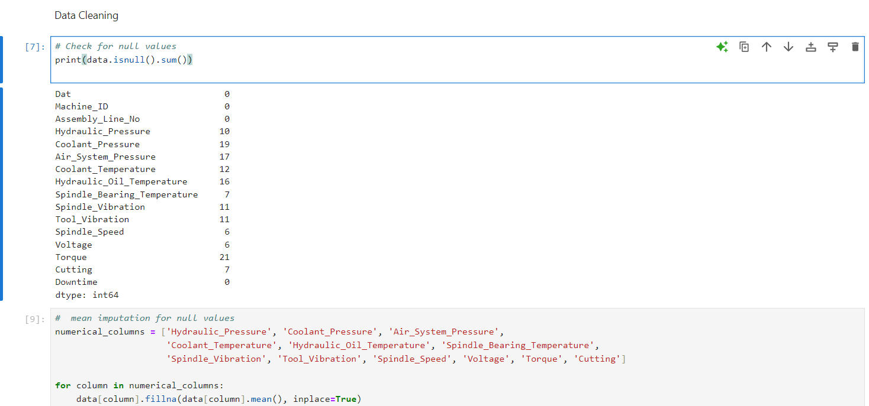
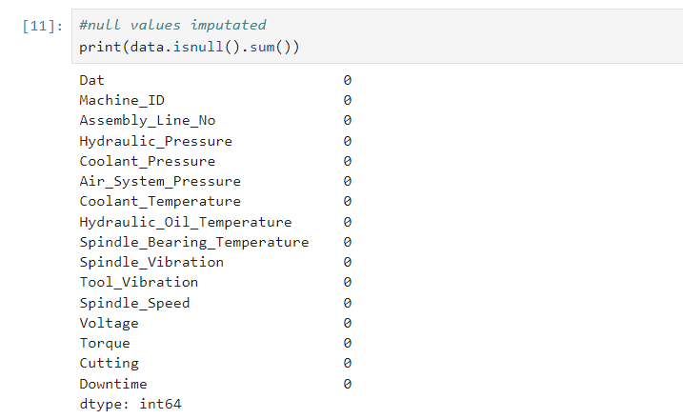
Exploratory Data Analysis [EDA]

Slide 10
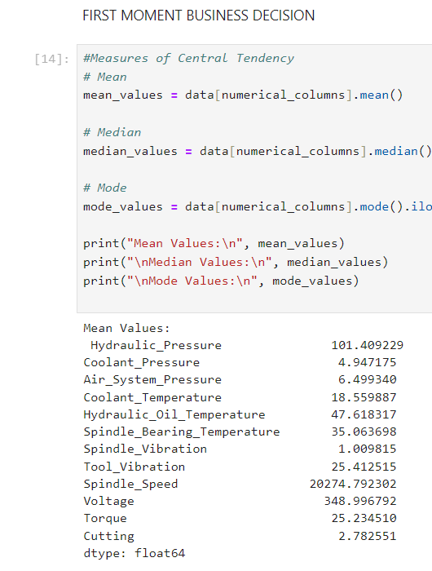
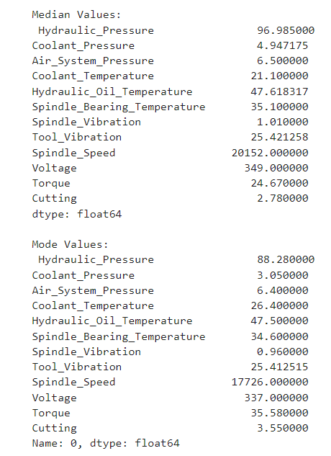
Exploratory Data Analysis [EDA]

Slide 11
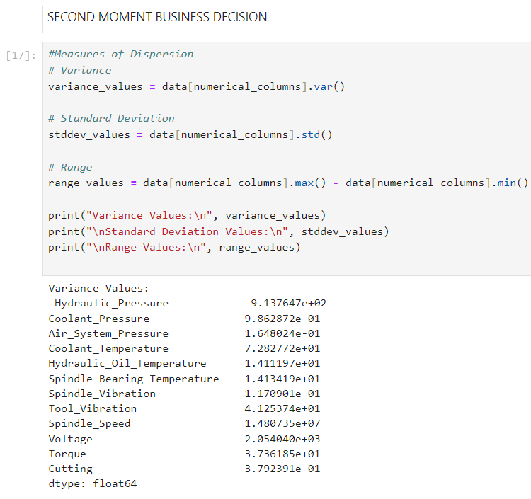
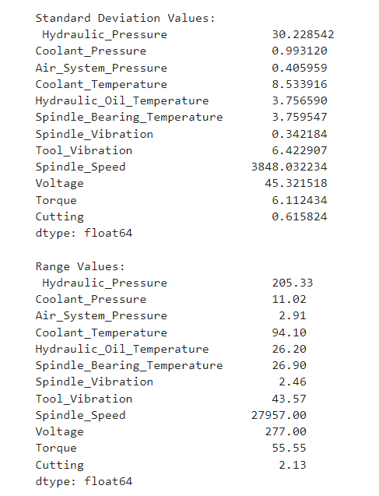
Exploratory Data Analysis [EDA]

Slide 12
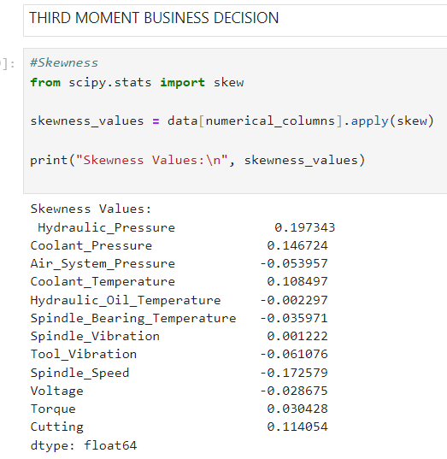
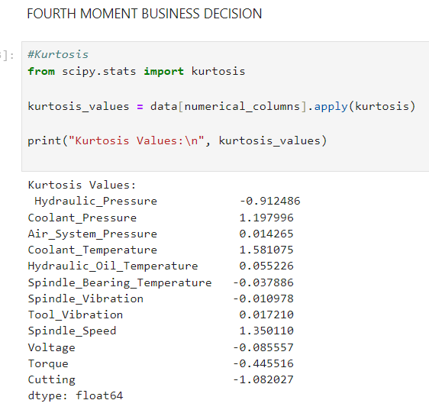
Exploratory Data Analysis [EDA]

Slide 13
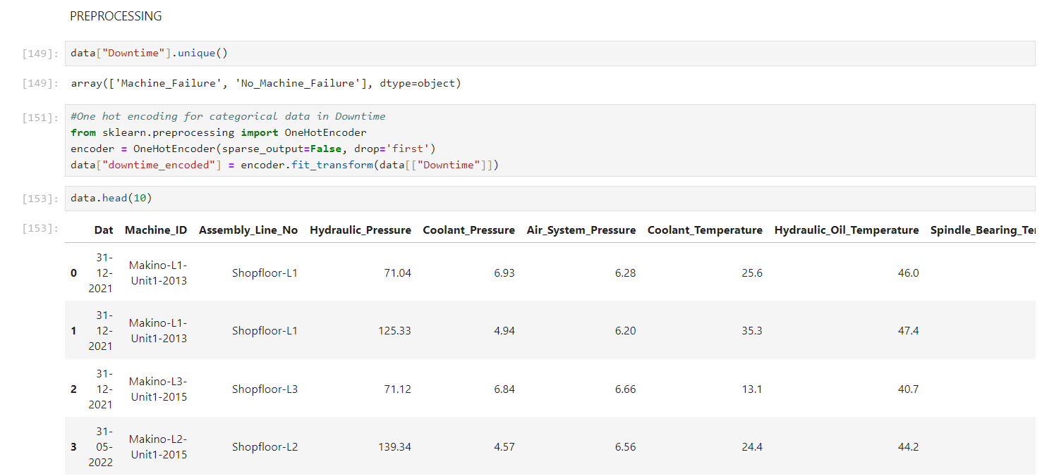
Data Preprocessing

Slide 14
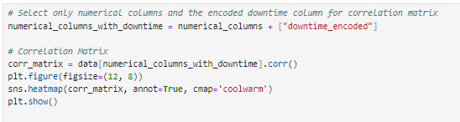
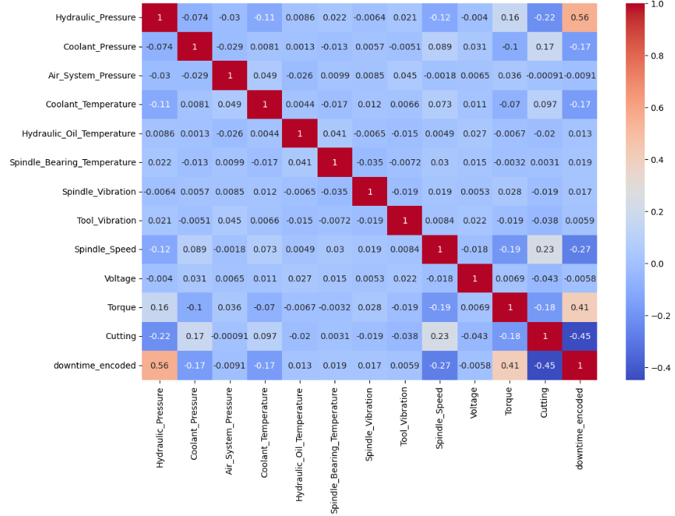
DATA VISUALIZATION

Slide 15
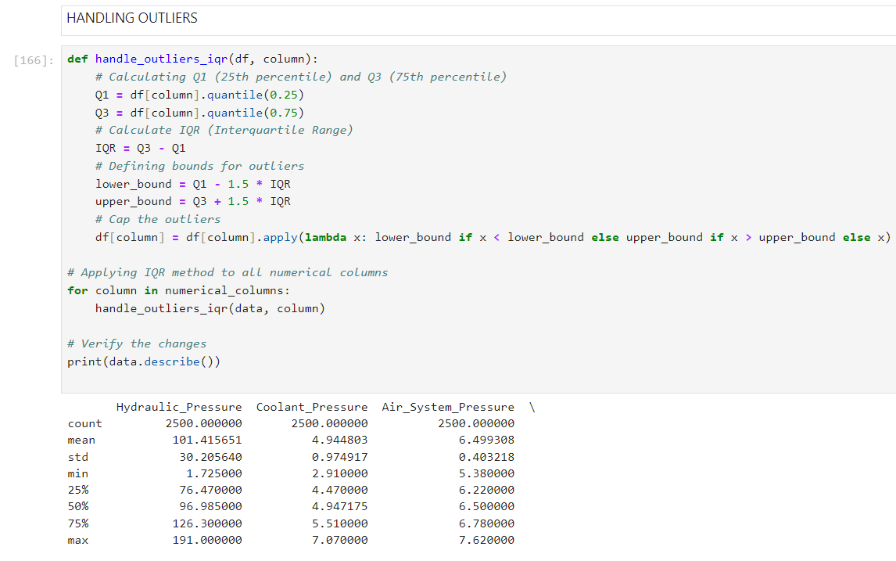
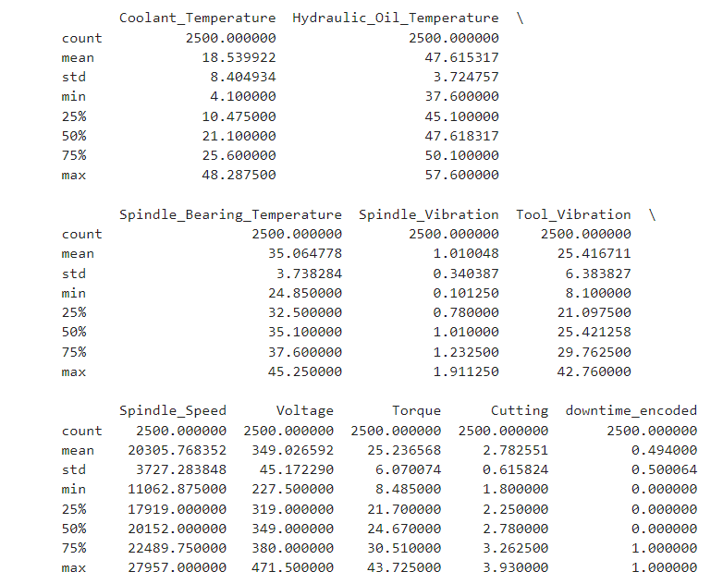
Data Preprocessing

Slide 16
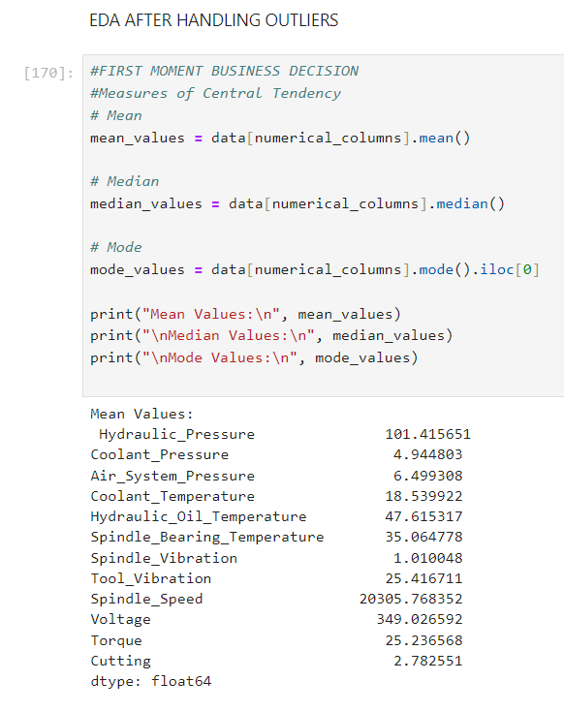
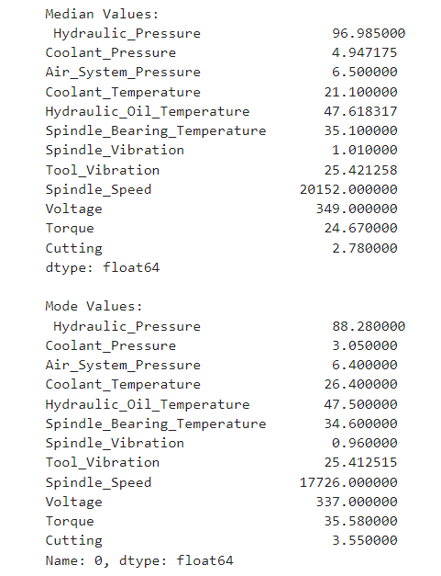
Exploratory Data Analysis [EDA]

Slide 17
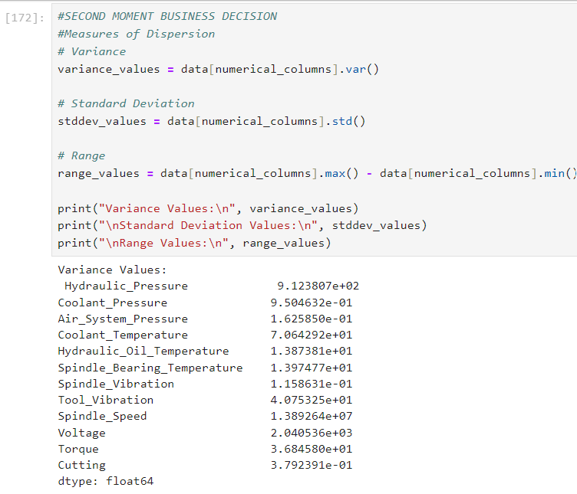
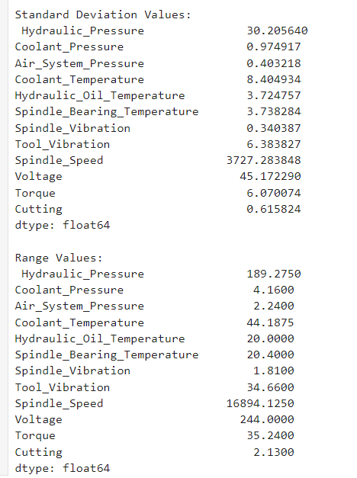
Exploratory Data Analysis [EDA]

Slide 18
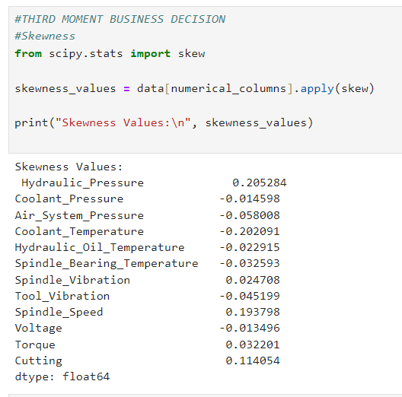
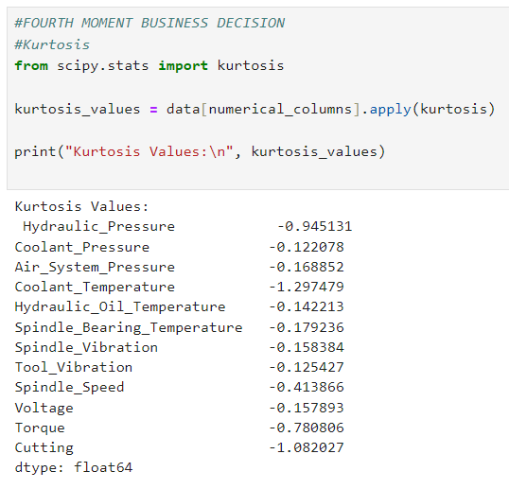
Exploratory Data Analysis [EDA]

Slide 19
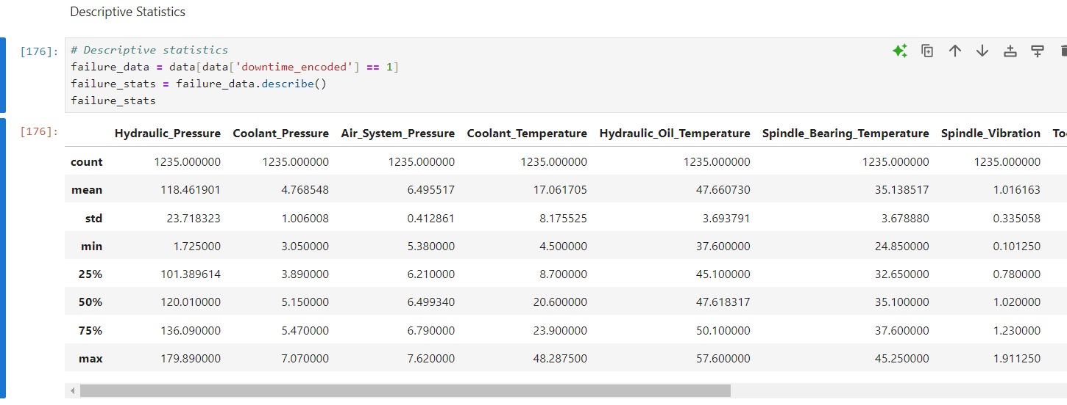
Data Preprocessing

Slide 20
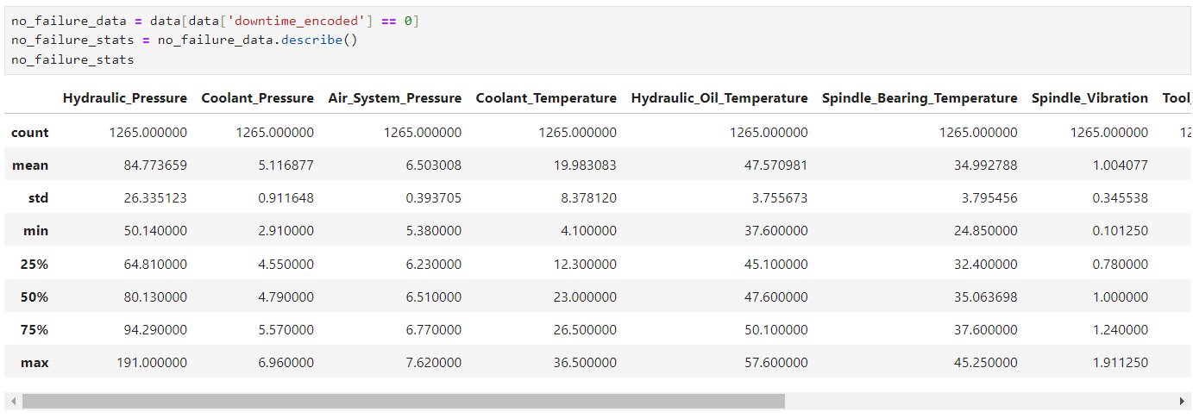
Data Preprocessing

Slide 21
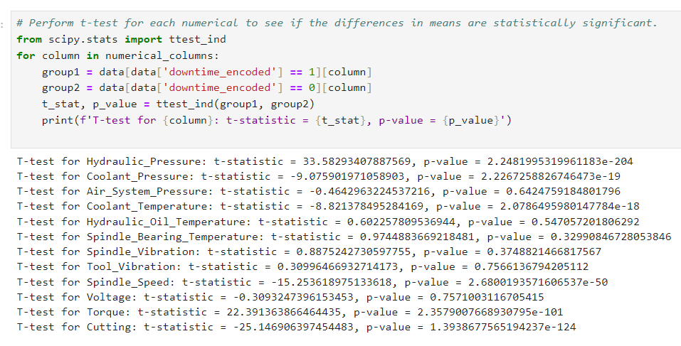
Data Preprocessing

Slide 22
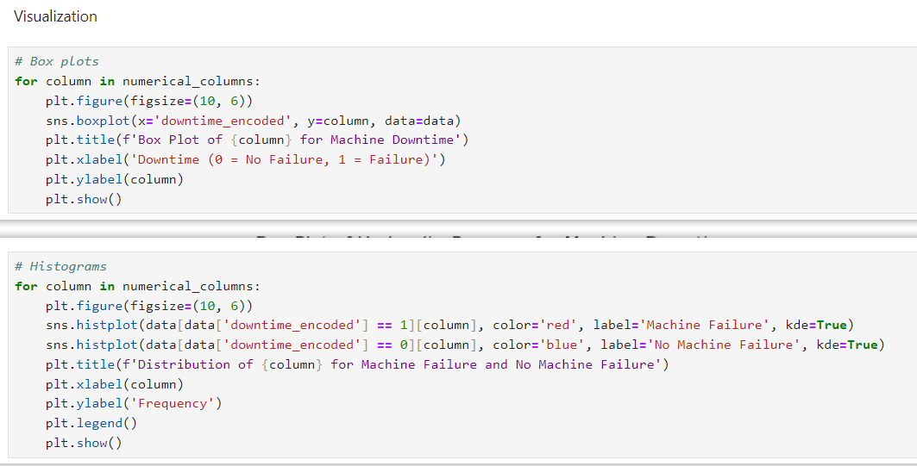
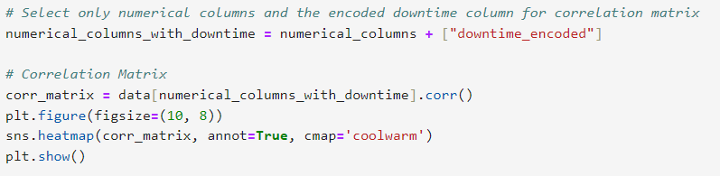
Data Visualization

Slide 23
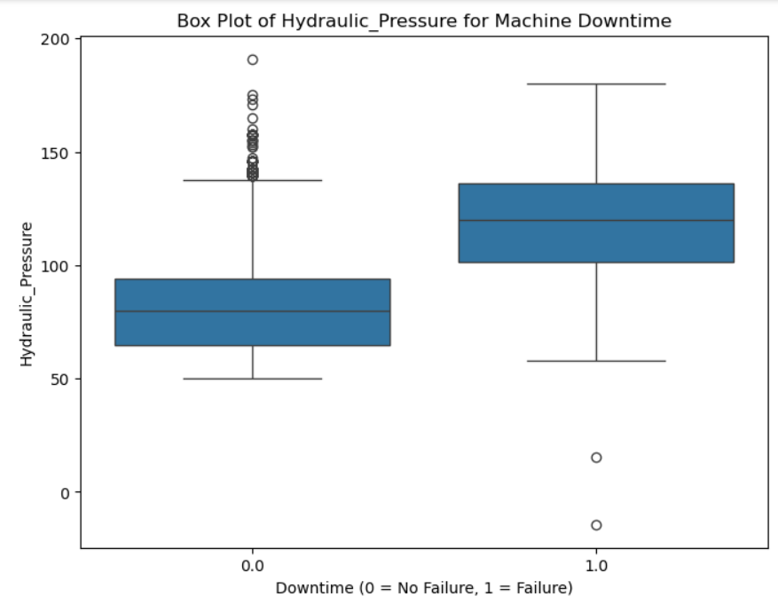
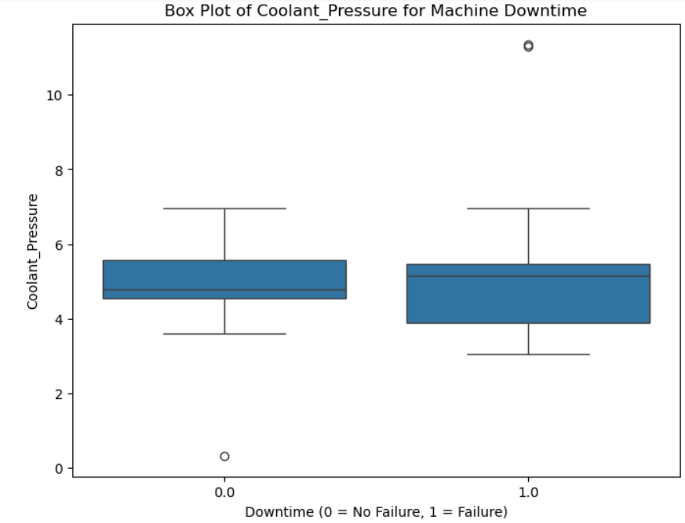
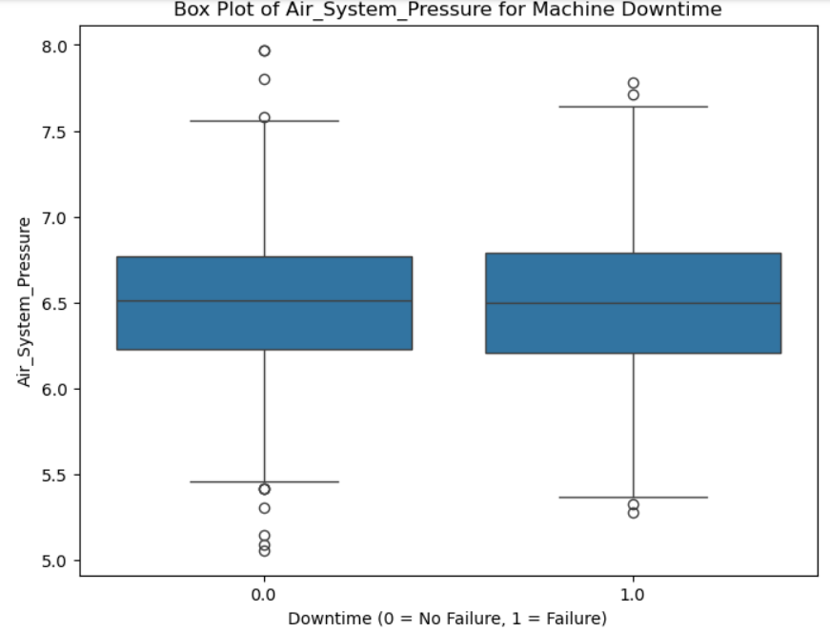
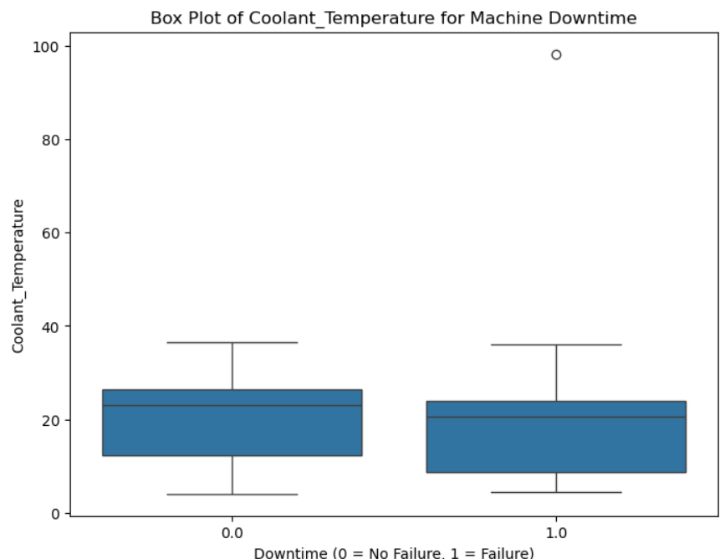
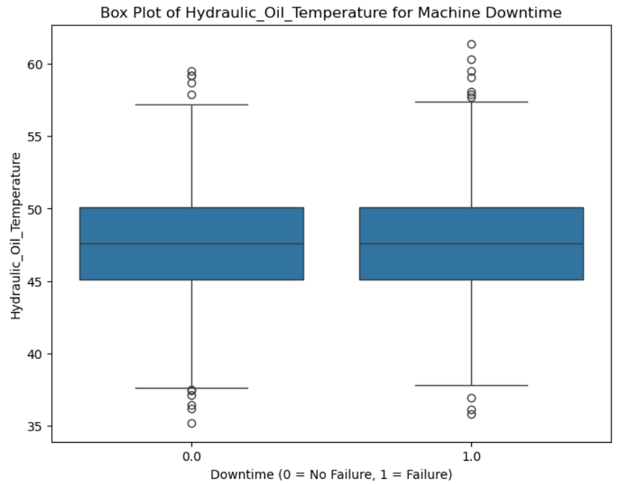
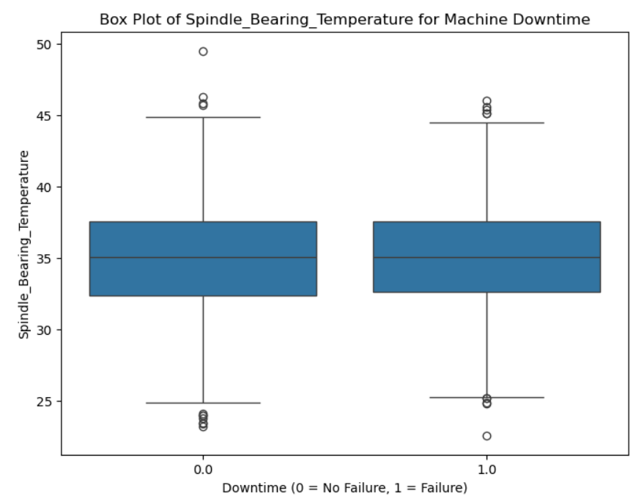
Data Visualization

Slide 24
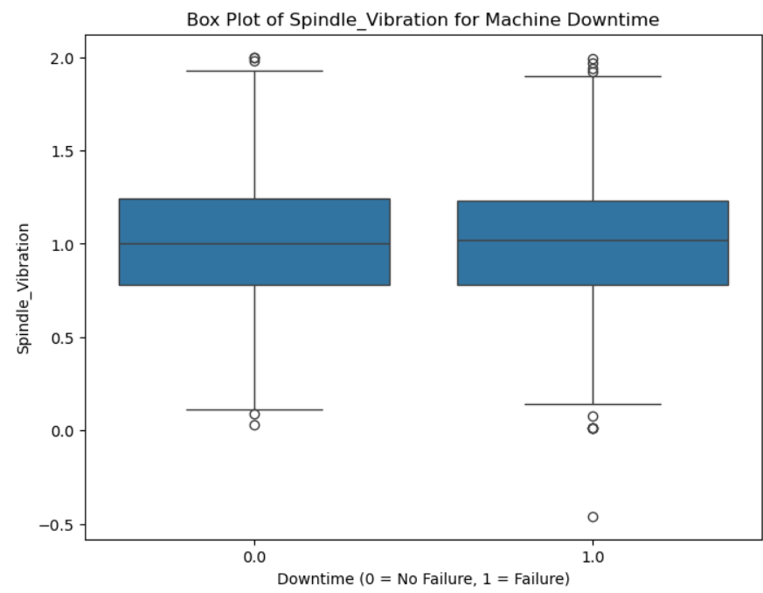
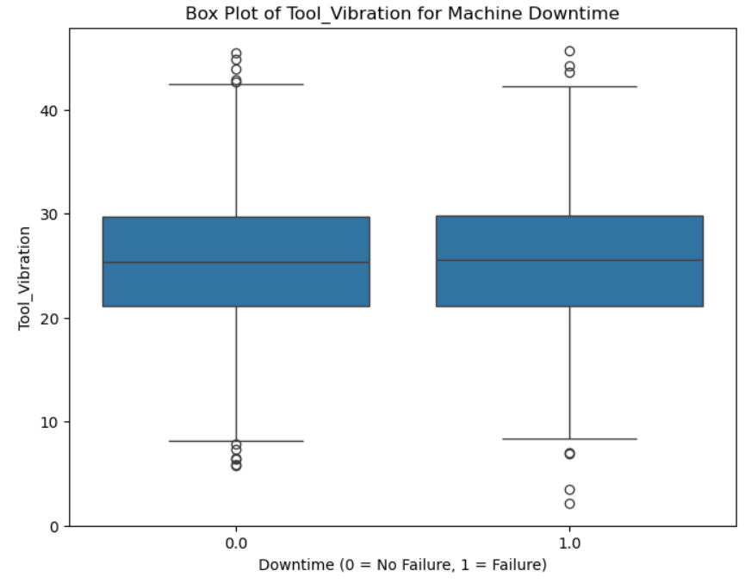
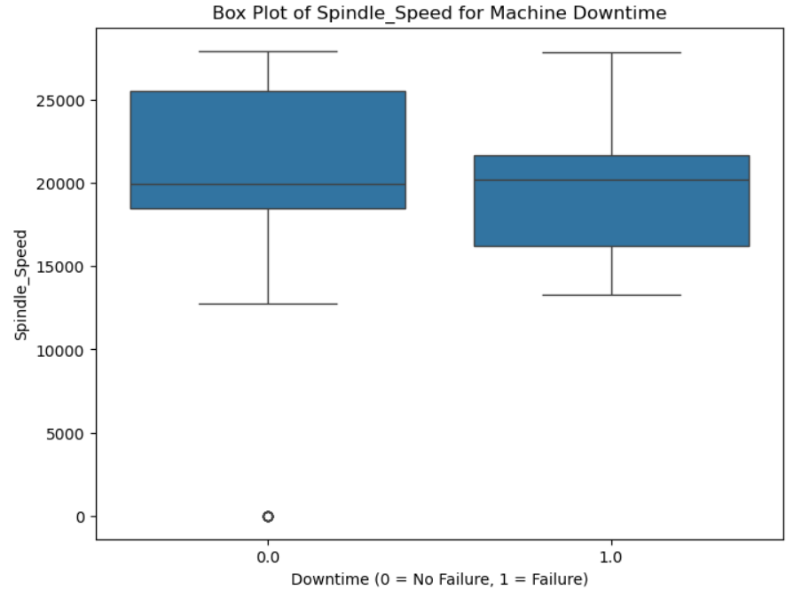
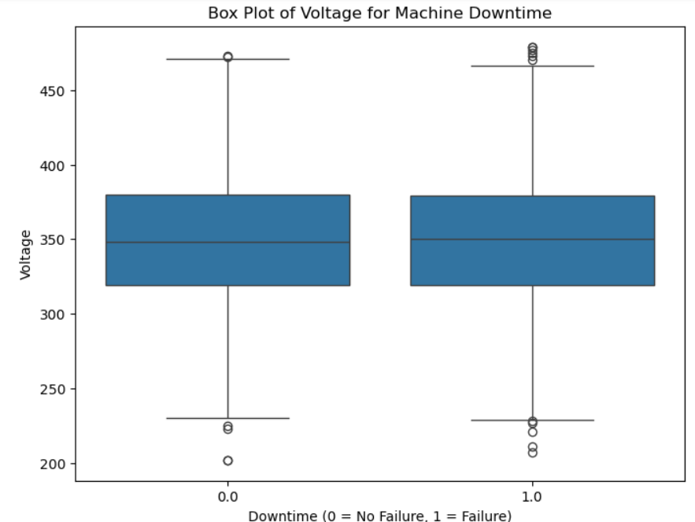
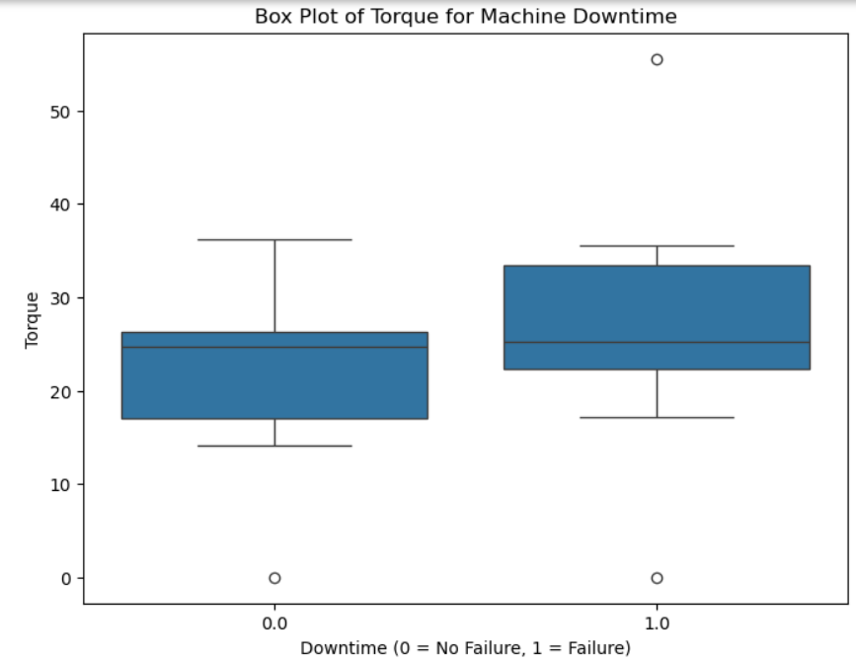
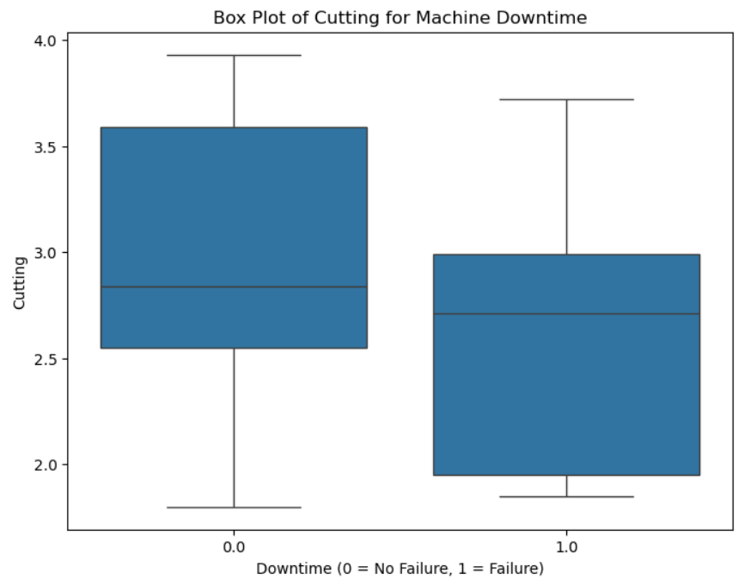
Data Visualization

Slide 25
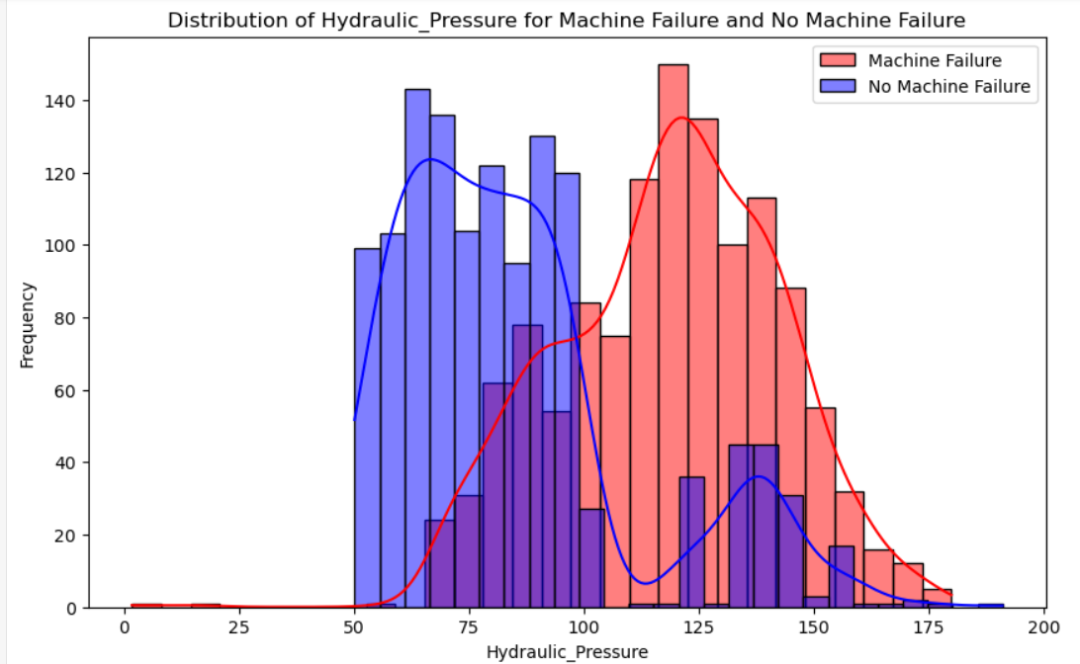
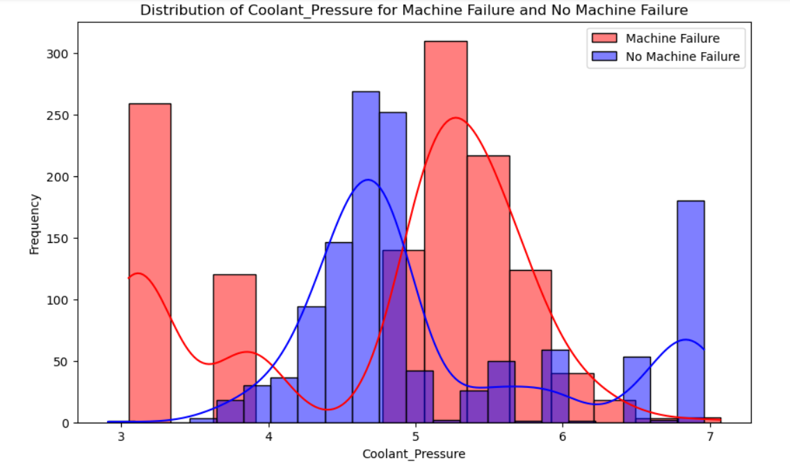
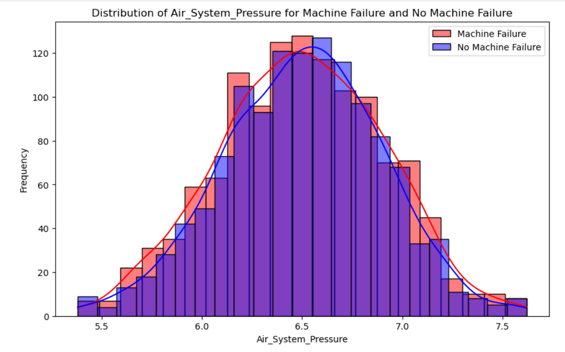
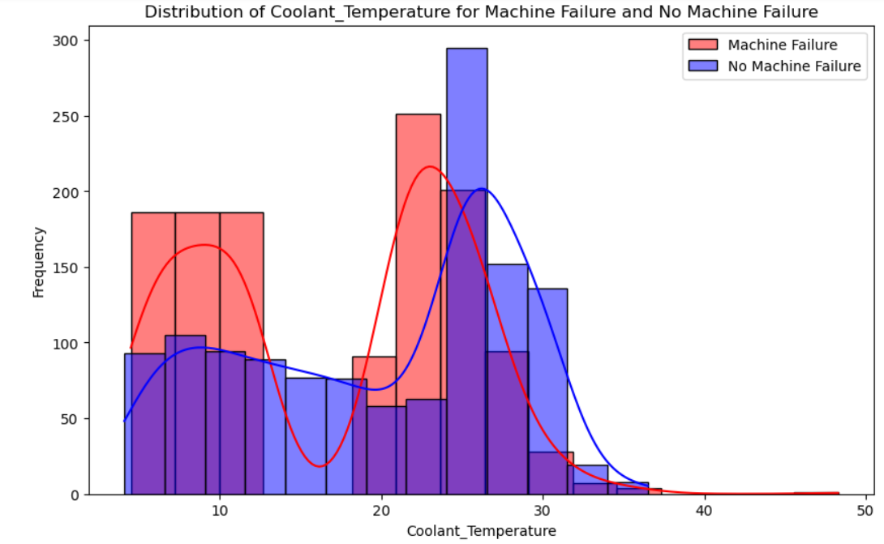
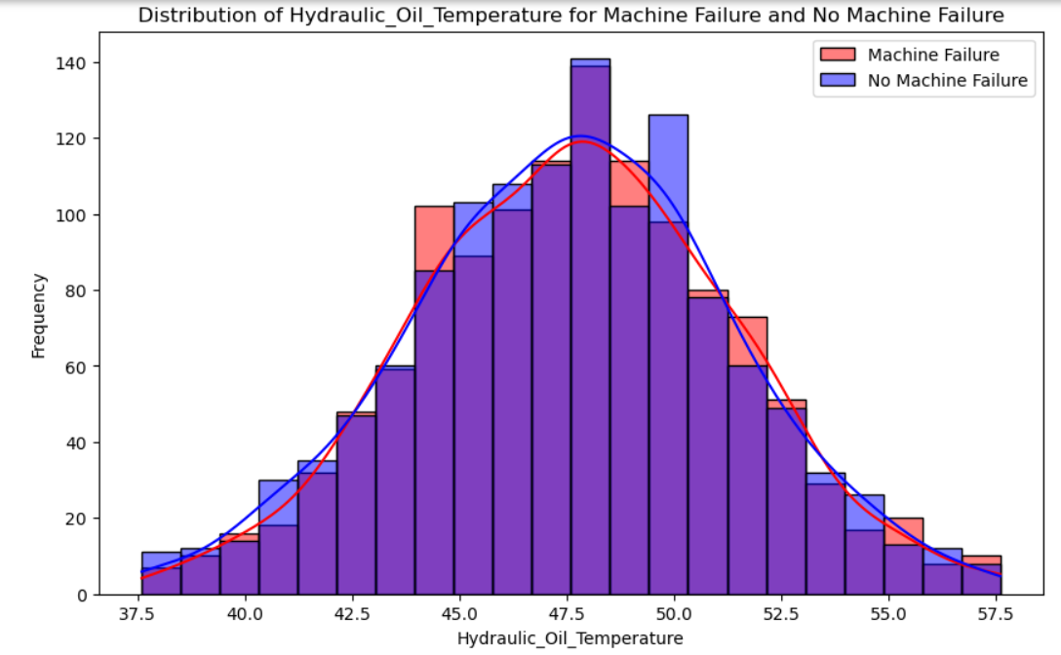
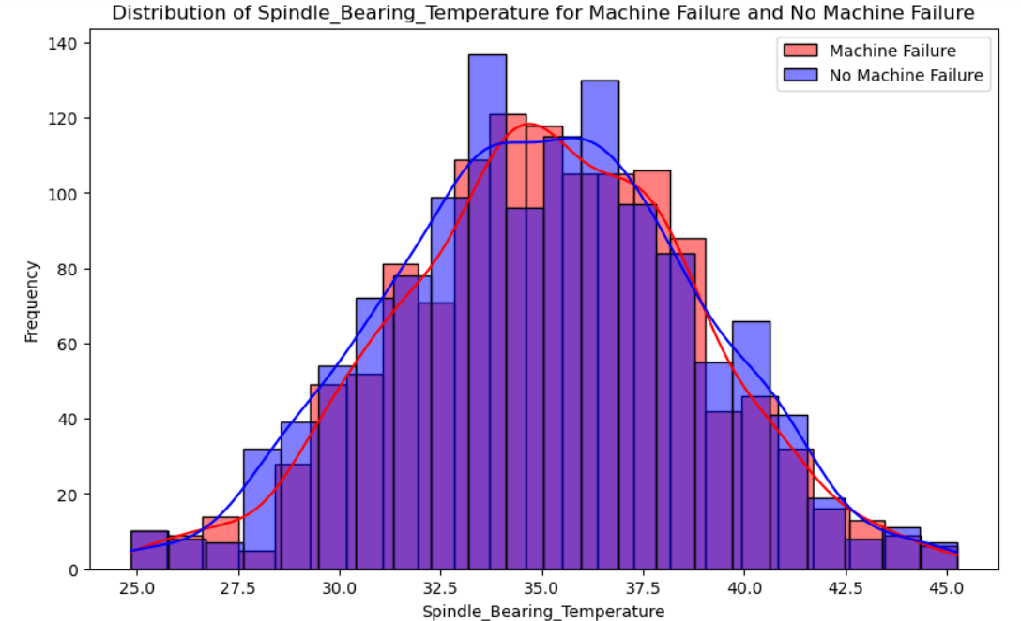
Data Visualization

Slide 26
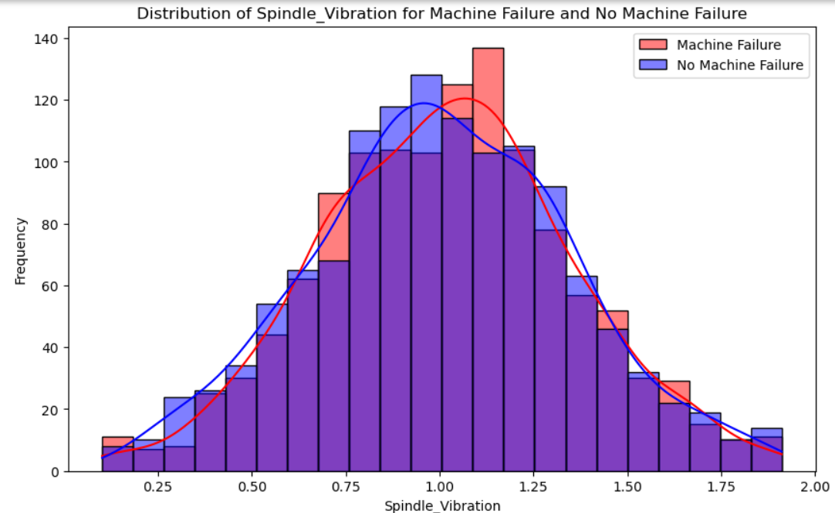
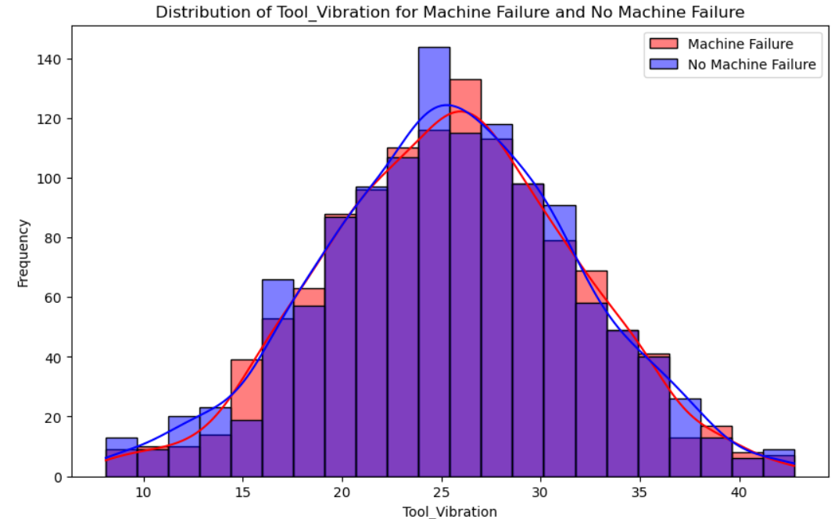
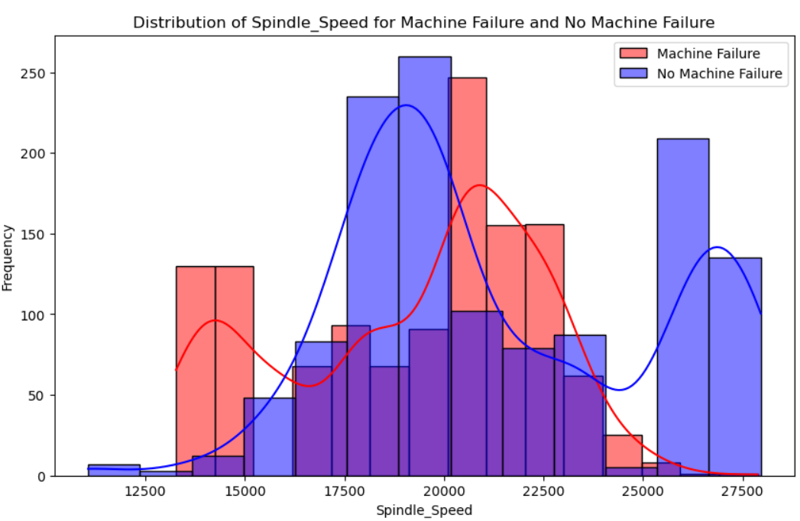
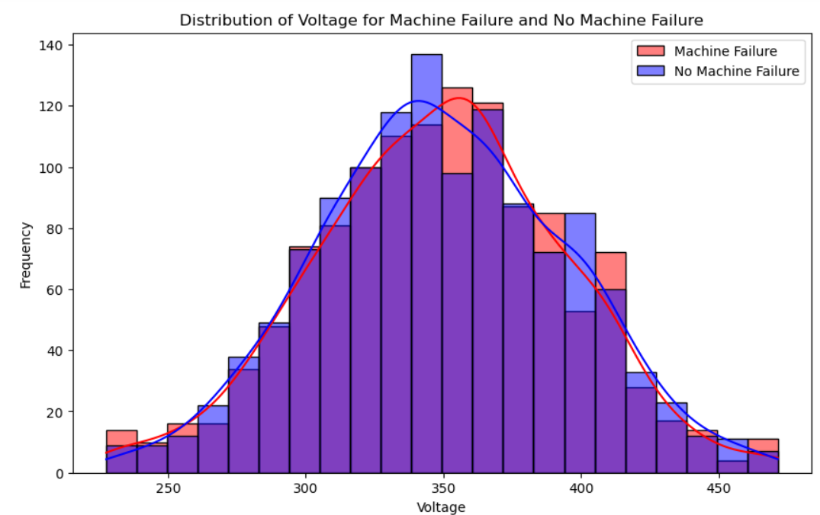
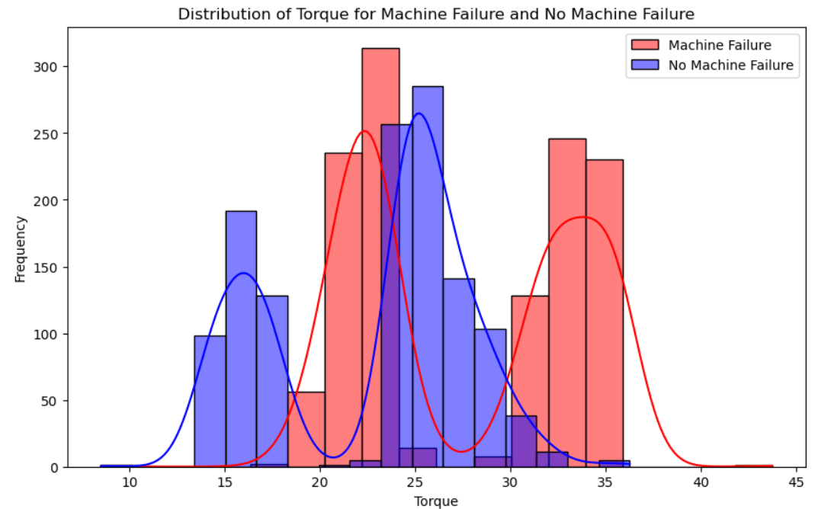
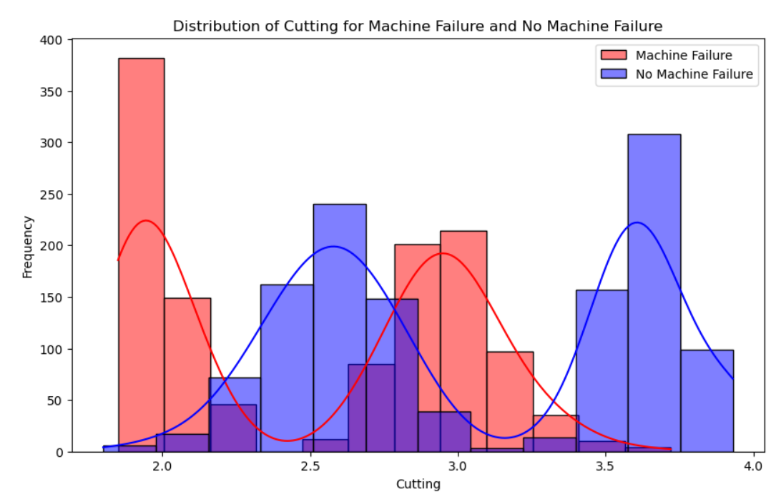
Data Visualization

Slide 27

Data Visualization

Slide 28
INSIGHTS
Looking at p-value, histogram and box-plot.
Hydraulic_Pressure,Coolant_Pressure,Coolant_Temperature,Spindle_Speed,Torque and Cutting are variables significantly associated with machine downtime failure.
Air_System_Pressure,Hydraulic_Oil_Temperature,Spindle_Bearing_Temperature,Spindle_Vibration,Tool_Vibration,Voltage are variables less significantly associated with machine downtime failure.

Slide 29
Recommendations
Regular Monitoring: Ensure real-time monitoring of hydraulic pressure, coolant pressure/temperature, and spindle vibrations.
Predictive Maintenance: Implement predictive maintenance strategies to foresee and address potential failures.
Training: Train operators on maintaining optimal levels of these variables and using monitoring tools.
Maintenance Schedule: Establish a robust maintenance schedule focusing on critical factors identified.

Slide 30


